Slide 1
Technical Support (420-1N6-AB) Logic Gates and Boolean Algebra
Fall 2023
Adapted for Fall 2024

Slide 2
Logic Gates and Boolean Algebra

Slide 3
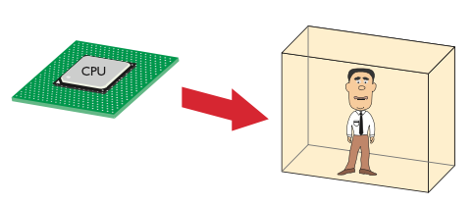
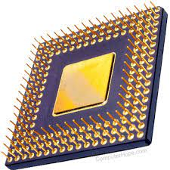
Logic in Computing
Review: CPUs work by receiving messages in the form of a series of 0s and 1s.
Based on the values of the 0s and 1s, and how the CPUs are preprogrammed, the CPU can perform arithmetic and make logical decisions to produce reliable output.
But, how are “decisions” made? Using a component called a logic gate: a device that output a signal only under controlled logical conditions.
But, how do logic gates work?

Slide 4
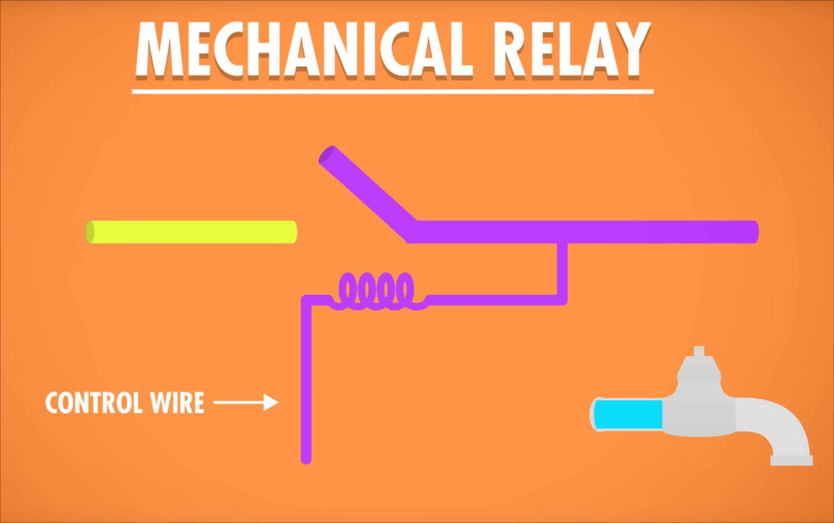
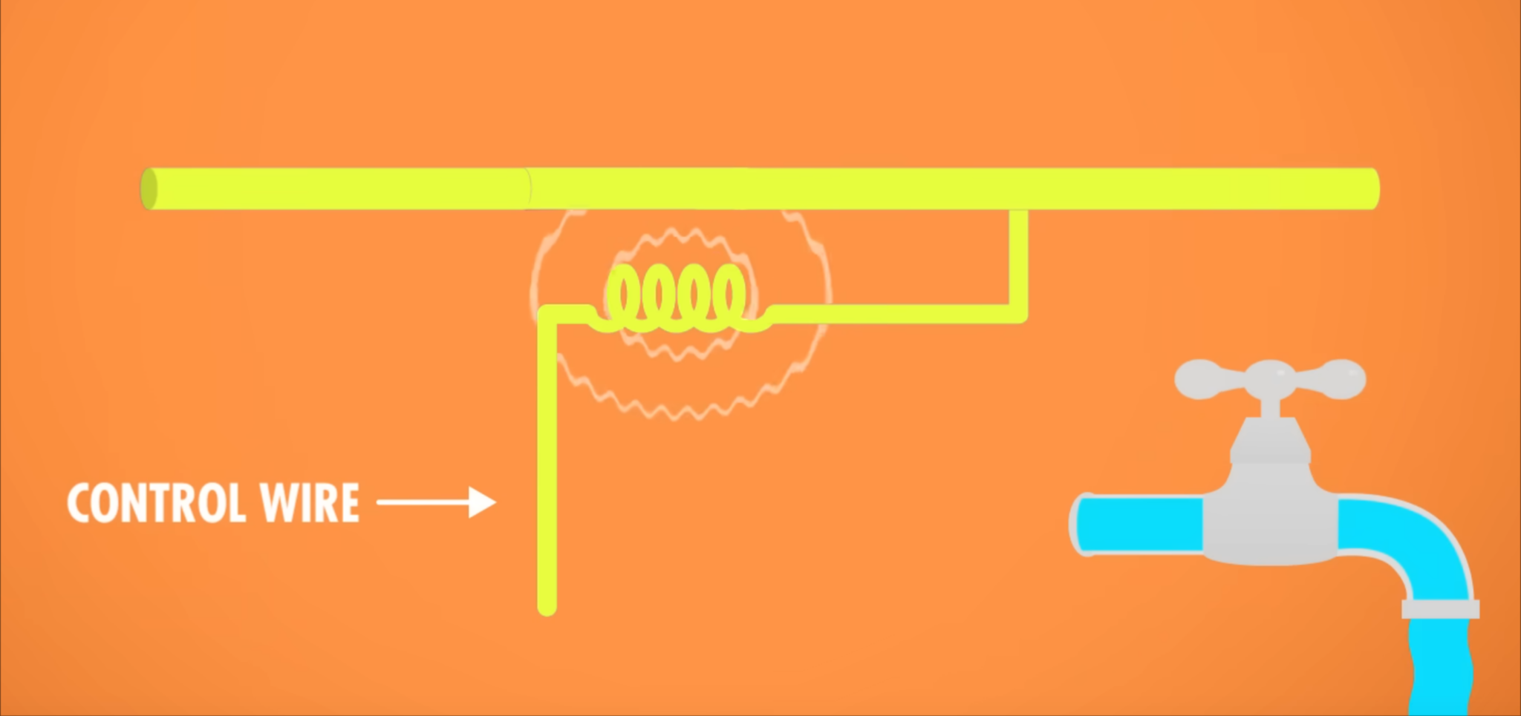
Physics behind 0s and 1s: Mechanical Relay
Mechanical Relays (late 19th/early 20th century)
Power source attached to Control wire with coil
When control wire on, electromagnetic field created by coil, which “snaps” the circuit shut
Result: control wire behaves like the tap on a faucet: allows electrons to pass through when on, otherwise off
Figures from the great PBS youtube series Crash Course Computing

Slide 5
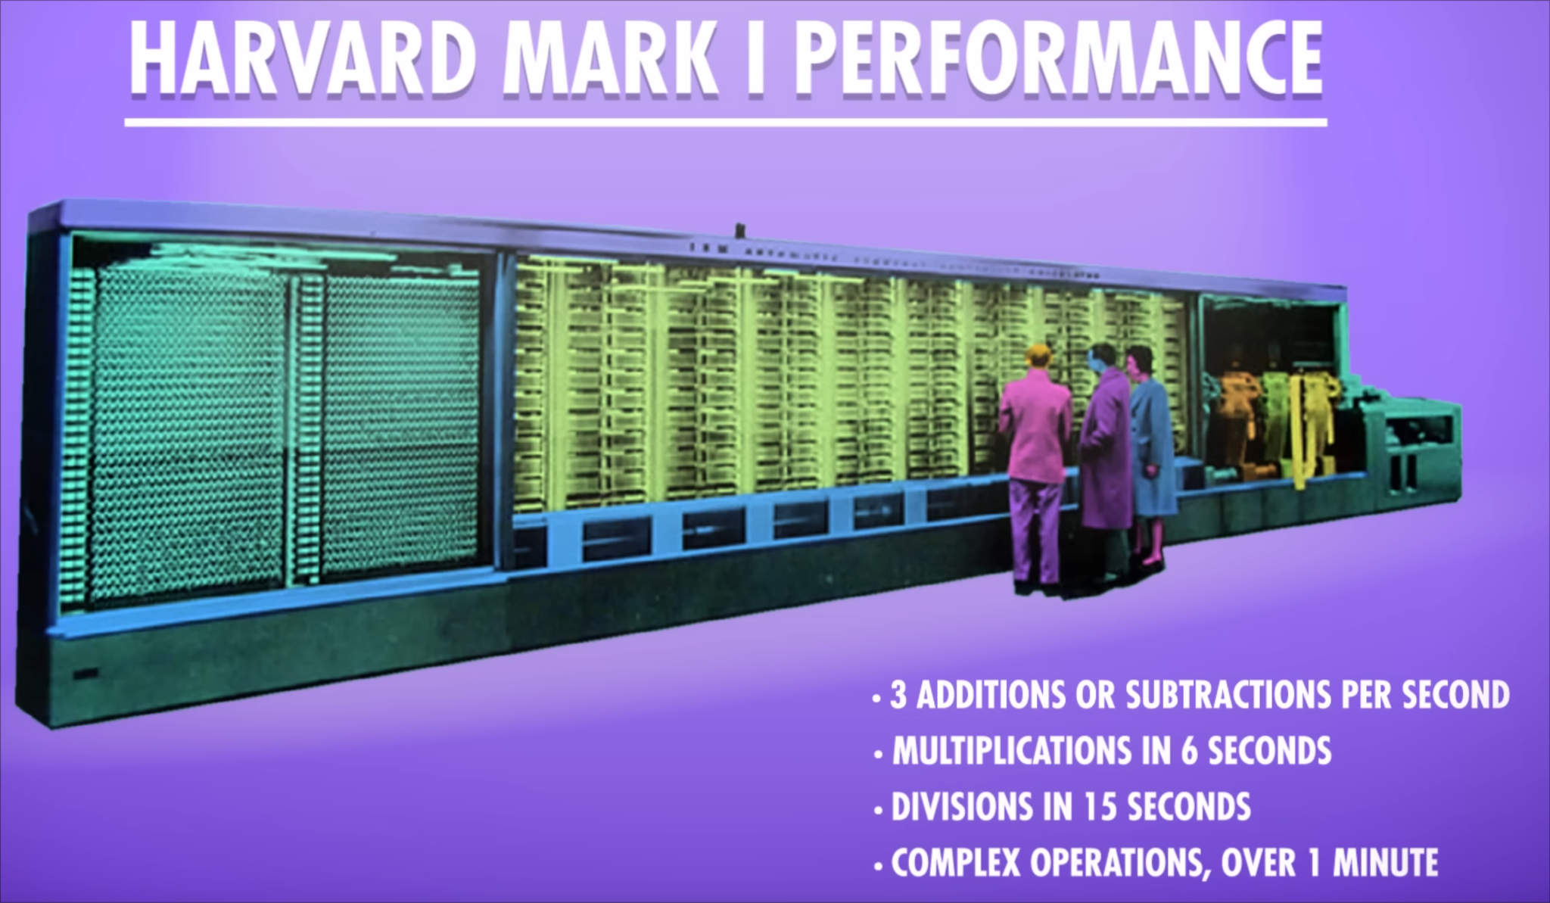
Physics behind 0s and 1s: Mechanical Relay
Pros:
first industrialized logic switch
capable of performing basic and complex computing operations
Cons
Large, slow, expensive, fragile, bug prone
Moving metal parts would wear down with each computation
Literally “bug” prone: large enough to trap cockroaches, which caused malfunctions!
Figure from the great PBS youtube series Crash Course Computing

Slide 6


Physics behind 0s and 1s: Vacuum Tubes
Vacuum Tubes (early 20th century)
Similar to Mechanical relay: a control wire connected to a circuit, this time contained in a vacuum (very low pressure, very small number of air molecules)
Control wire off: circuit disconnected
Control wire on: electrons flow in the tube, completing the circuit
Figures from the great PBS youtube series Crash Course Computing

Slide 7
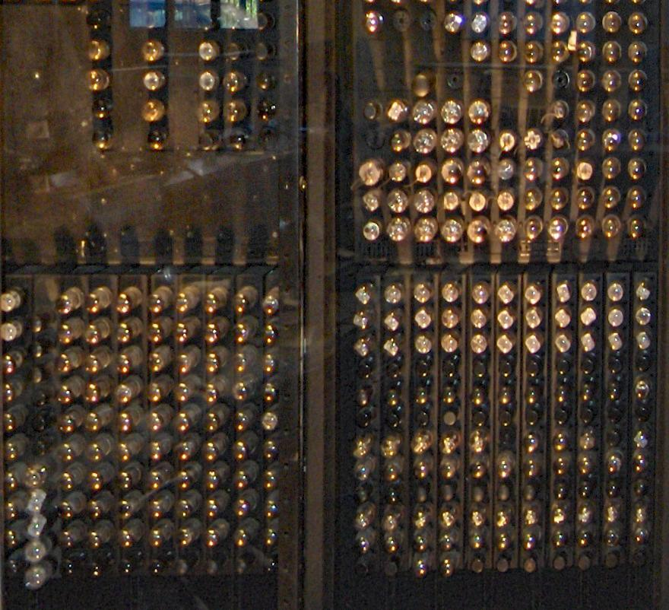
Physics behind 0s and 1s: Vacuum Tubes
Cons
Similar to Mechanical relay: large, expensive, fragile
Pros
Much faster than relays! 5000 additions/subtractions per second
No moving parts! Turning on/off did not require anything physical to move, reducing wear over time and increasing reliability
With research, vacuum tubes became mass producible.
1946 ENIAC – First programmable electronic (stands for Electronic Numerical Integrator and Computer). Each “bulb” is an individual vacuum tube!

Slide 8
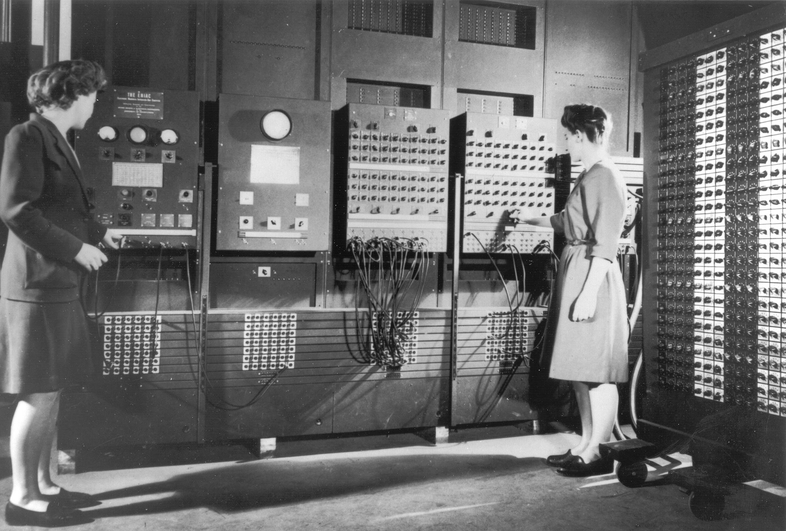
First General-Purpose Computer: ENIAC
The ENIAC was operational for 10 years, and is estimated to have done more arithmetic than the entire human race up to that point (1946).
Programmers Betty Jean Jennings and Fran Bilas at the School of Electrical Engineering. The majority of early programmers in America were women, who operated machines like ENIAC. Interesting book about this: https://direct.mit.edu/books/monograph/3305/The-Computer-Boys-Take-OverComputers-Programmers
Facts and Figures from the great PBS youtube series Crash Course Computing

Slide 9

The advent of transistors
Vacuum tubes, though more reliable than relays, were prone to breakdowns.
A new component soon entered the scene:
Invented in 1947, transistors revolutionized the computing world.
They came to replace the vacuum tubes.
This is a 2nm IBM wafer containing hundreds if chips which allows 50 billion transistors onto a chip of a fingernail

Slide 10
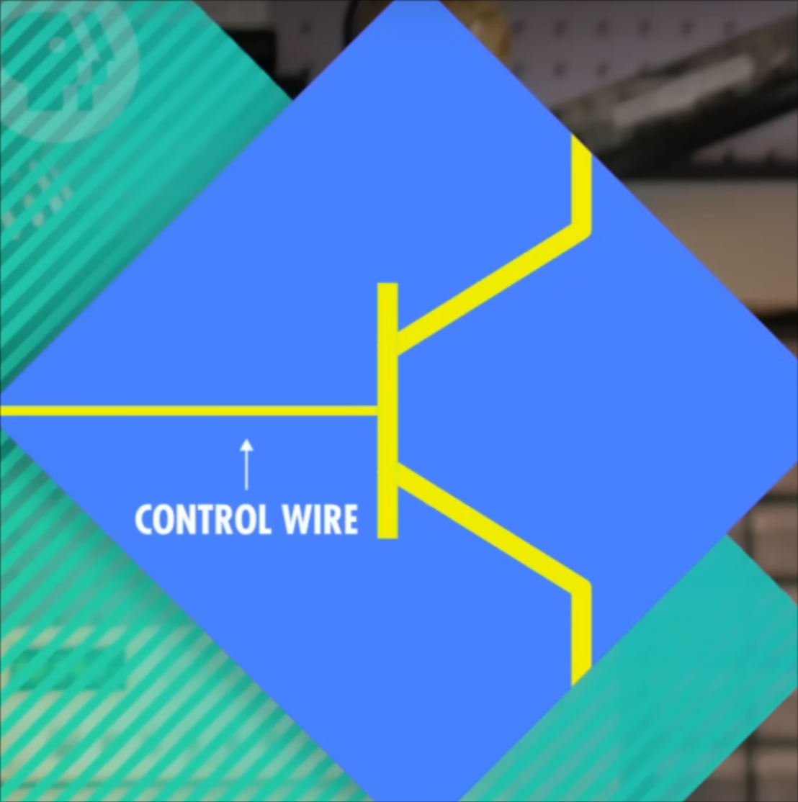
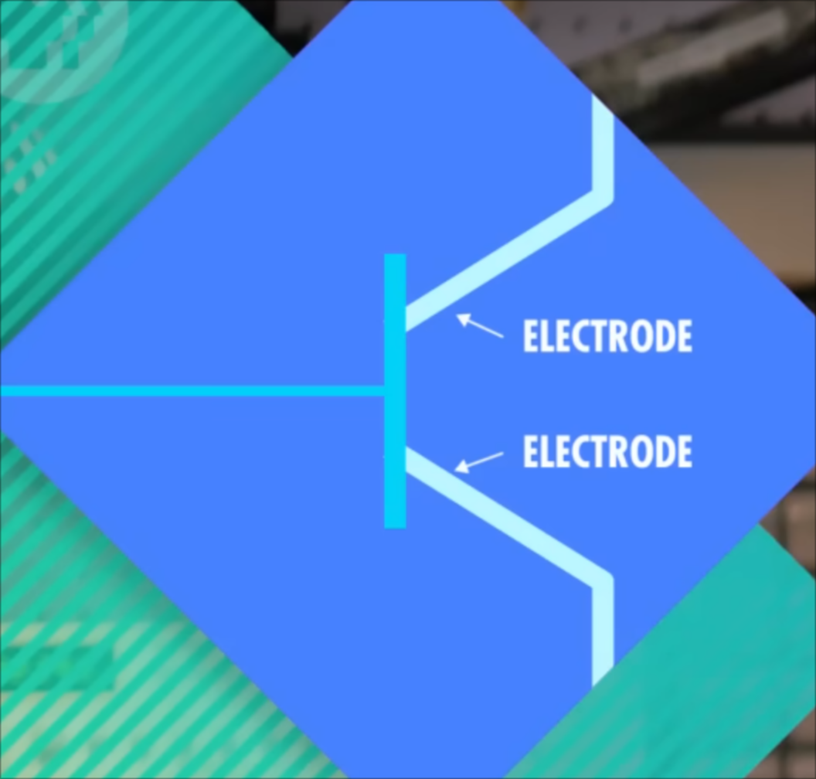
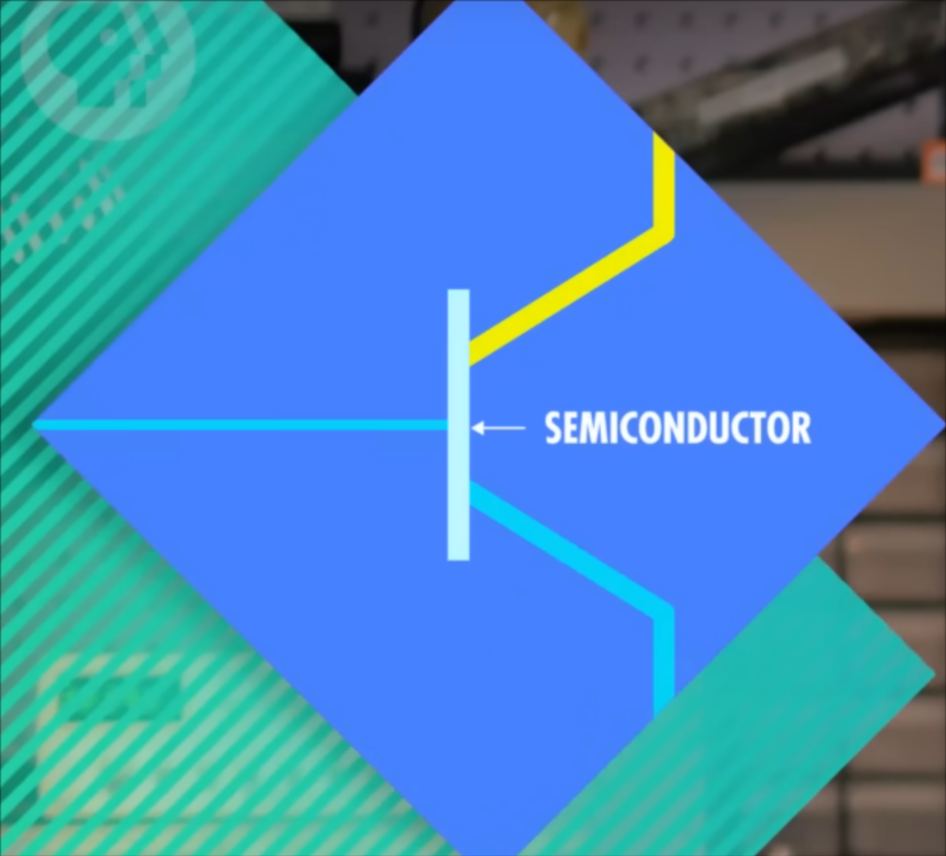
Physics behind 0s and 1s: Transistors
Transistors (1947)
Similar to previous: a control wire connected to a circuit, this time connected via a semiconductor to two electrodes: a power source and an output
Semiconductors sometimes conduct, and sometimes resist, electrical current.
Semiconductors are quantum mechanical phenomena: complex new physics at the time!
Control wire off: circuit disconnected
Control wire on: electrons flow in the tube, completing the circuit
Figures from the great PBS youtube series Crash Course Computing

Slide 11
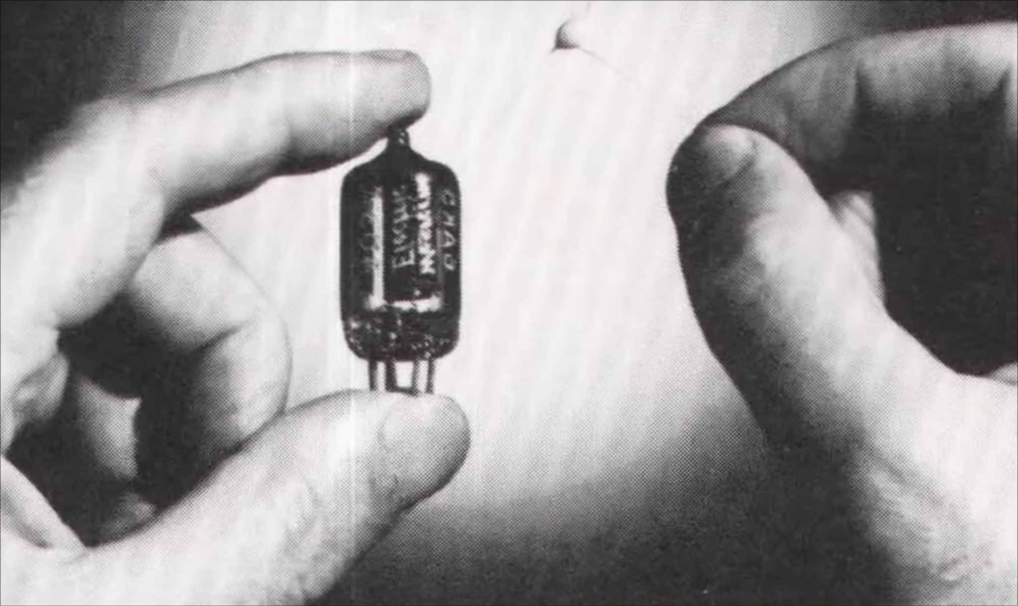
Physics behind 0s and 1s: Transistors
Cons
None!
Pros
Solid state: no moving parts, no need to maintain vacuum pressure.
Computes (opens/closes) at the same speed as the rest of the electrical components -- billions of times per second change in circuit state achieved
Mass producible
Remains the dominant computing technology today
Today, transistors can be as small as a few nanometers -- for reference, a sheet of paper is roughly 100,000 nanometers thick.

Slide 12
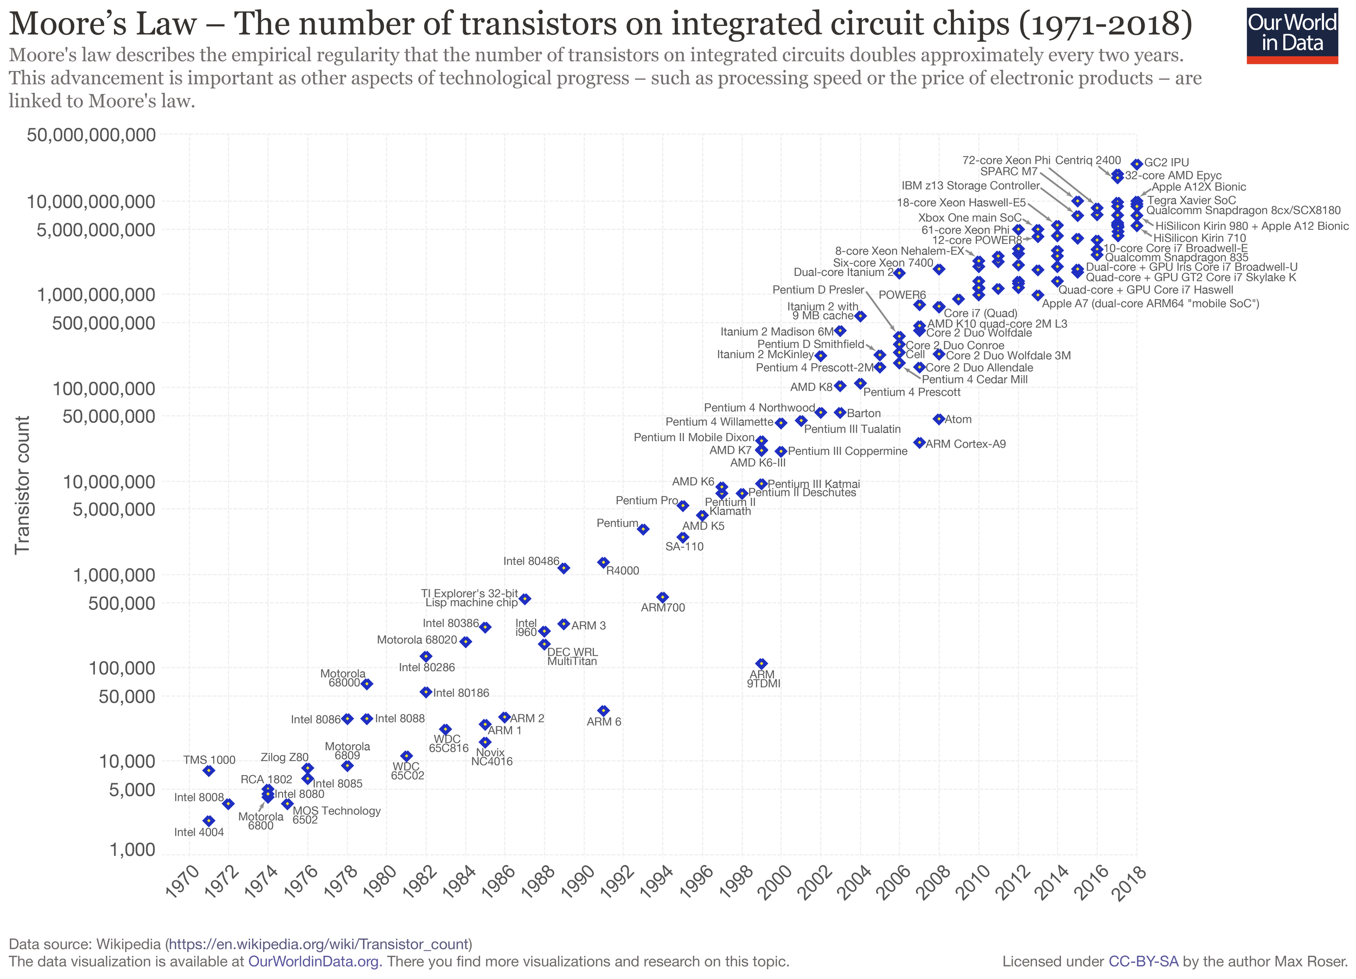
Transistors count in computers
Number of transistors in an integrated circuit (IC) doubles every two years. Moore’s Law
BUT! Since 2010, semiconductor advancement has slowed industry-wide.
Physical limits of transistors

Slide 13
What can be done with logic gates?
Logic gate state: no current = 0, current flowing = 1.
or: voltage off = 0, voltage on = 1
Logic gates let us physically create and control binary circuits.

Slide 14
A bit more theory: Boolean Algebra
Boolean algebra: the mathematics of digital logic
Name Boolean for mathematician George Boole
A special form of algebra where:
all possible values are true or false (0 or 1) called Boolean values
all operations turn Boolean values into either true or false, called Boolean operations
Used in the analysis and synthesis of logical expressions.
Demonstrated by Claude Shannon in 1940s: you can build digital circuits that can represent any boolean algebra statement -- therefore you could build computers to perform logic -- very powerful! (If you’re curious, here’s a link to his famous master’s thesis proving the equivalence) https://www.cs.virginia.edu/~evans/greatworks/shannon38.pdf

Slide 15
Logic in Electronics
With Boolean Algebra, Electrical circuits with Logic Gates can be designed to represent logical expressions
Known as logic circuits.
Used to make important logical decisions in household appliances, computers, communication devices, traffic signals and microprocessors.
Four basic logic operations we will learn today:
OR operation
AND operation
NOT operation
XOR operation (eXclusive Or)

Slide 16
Logic Gates
A logic gate is an electronic circuit/device which makes the logical decisions based on these operations.
Logic gates have:
One or more inputs
Only one output
Computes a Boolean operation.
The output is active only for certain input combinations.
Logic gates are the building blocks of any digital circuit.

Slide 17
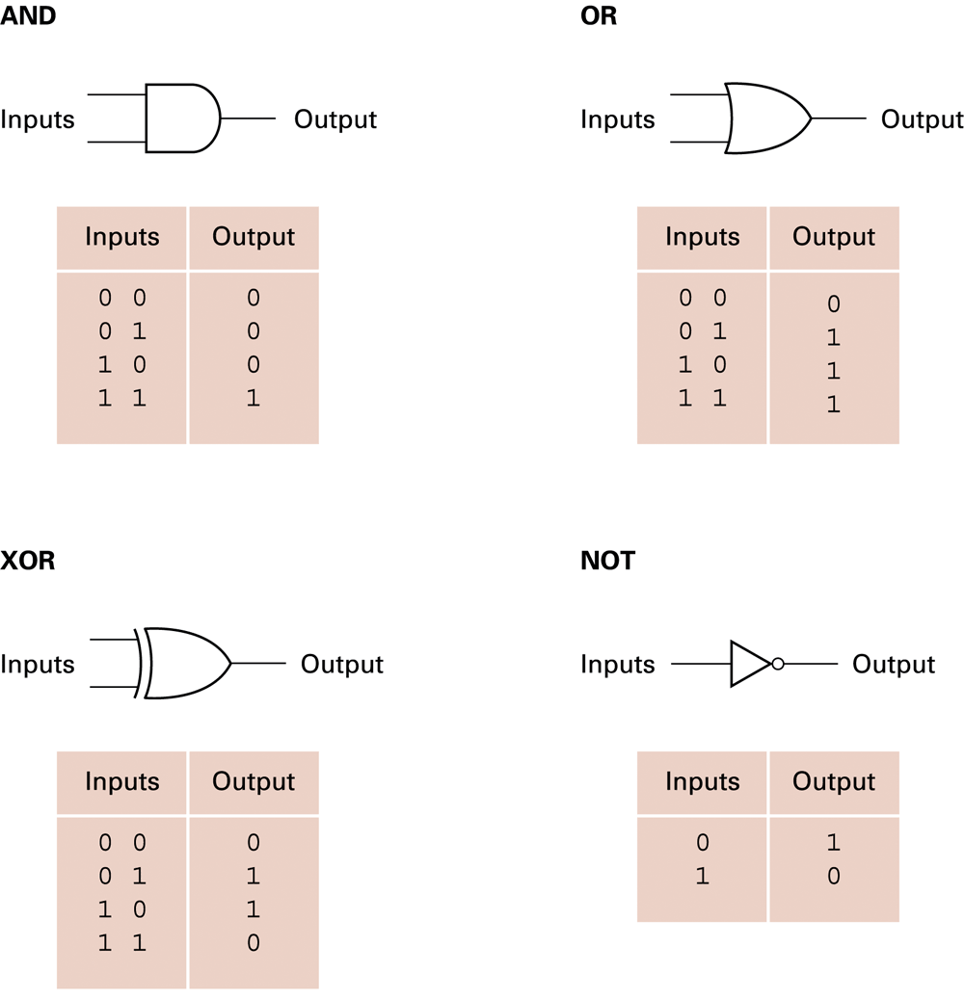
Logic Gate, Truth Tables, Boolean Algebra
Using Truth Tables we can use different sets of logic operations to store, add, subtract, and perform more complicated operations with bits.
We will learn the Boolean Operations associated with each logic gate to help us understand digital circuits analytically

Slide 18


Boolean Operations: AND Gate
Truth Table (1 = TRUE, 0 = FALSE)
Inputs Output A B A⋅B
0 0 0
0 1 0
1 0 0
1 1 1
AND Operation
Both input values must be TRUE for output to be TRUE
Similar to MULTIPLICATION in elementary algebra:
0⋅0 = 0, 0⋅1 = 0, 1⋅0 = 0, 1⋅1=1
Operation symbols:
A⋅B, A^B, A&&B, A and B
0
0
0
A
A⋅B
0
B
0
1
1
0
0
1
1
1

Slide 19
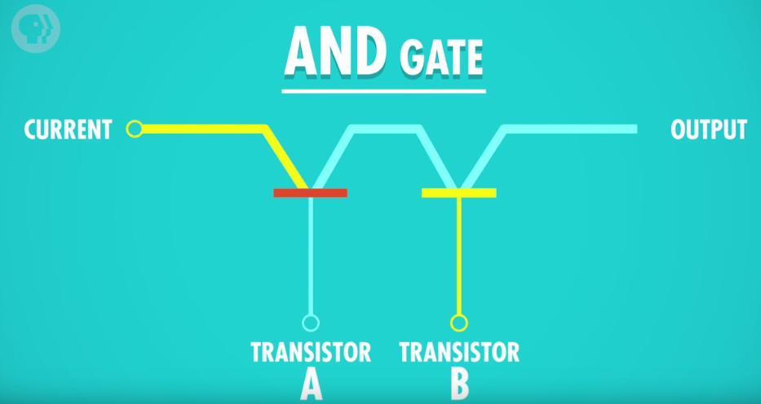
AND Gate
To build an AND gate: Two transistors connected together in series
Series: the output of the first element is connected directly to the input of the second element, in sequence
Key: both transistors have to be on for the total gate to be on. Just like the AND operation!
Two inputs (transistors A and B) and one output
Example 1:
Transistor A: Off (False)
Transistor B: On (True)
Output: Off (False)
Off (False)
Off (False)
On (True)

Slide 20
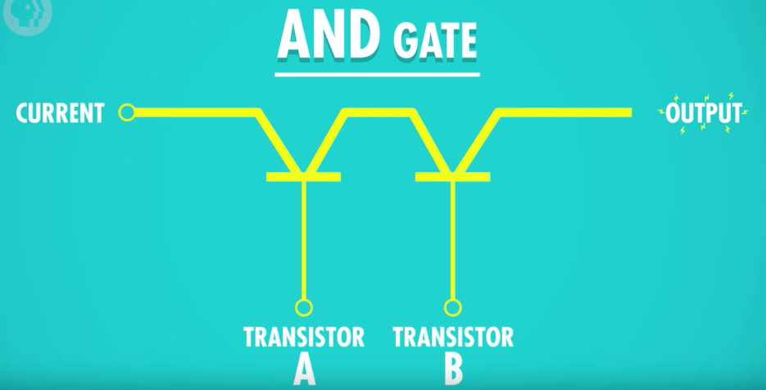
AND Gate
Example 2:
Transistor A: On (True)
Transistor B: On (True)
Output: On (True)
On (True)
On (True)
On (True)

Slide 21

Boolean Operations: OR Gate
Truth Table (1 = TRUE, 0 = FALSE)
Inputs Output A B A⋅B
0 0 0
0 1 1
1 0 1
1 1 1
OR Operation⋁
Both input values must be FALSE for output to be FALSE
Similar to ADDITION in elementary algebra:
0+0 = 0, 0+1 = 1, 1+0 = 0, 1+1=1… wait what?
Operation symbols:
A+B, A⋁B , A||B, A or B
0
0
0
A
A+B
0
B
1
1
1
1
0
1
1
1

Slide 22
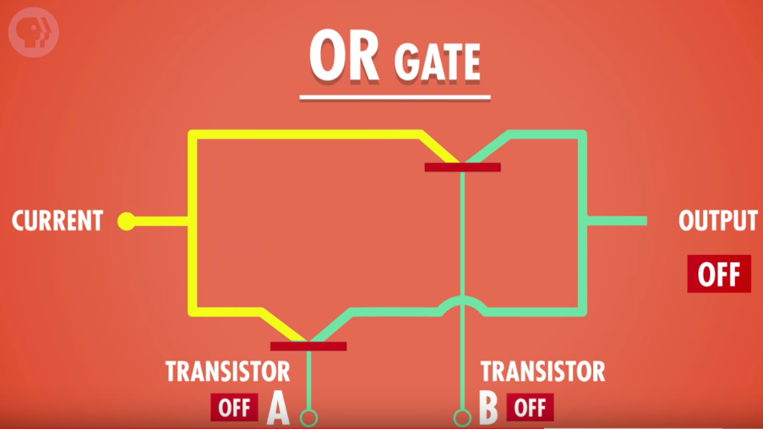
OR Gate
To build an OR gate: Two transistors connected together in parallel
Parallel: the inputs and outputs of all elements are connected to the same line, the elements are in parallel
Key: turning either transistor on will have the effect of turning the whole gate on. Just like the OR operation!
Example 1:
Transistor A: Off (False)
Transistor B: Off (False)
Output: Off (False)

Slide 23
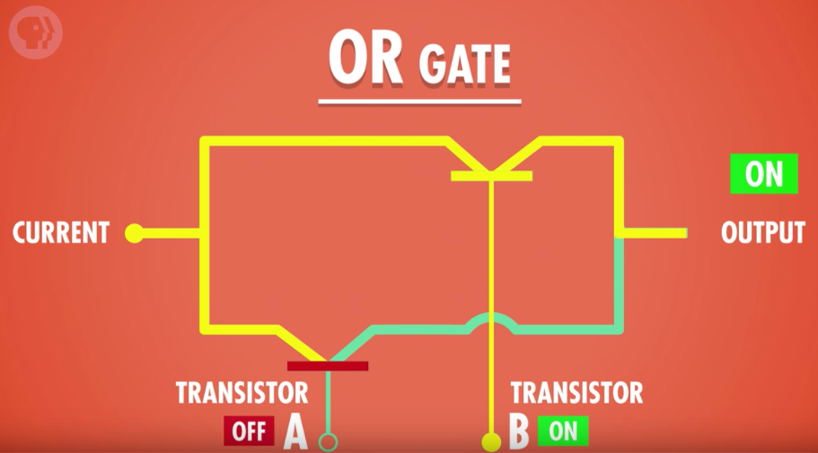
OR Gate
Example 2:
Transistor A: Off (False)
Transistor B: On (True)
Output: On (True)

Slide 24

Boolean Operations: NOT
A
A’
Truth Table
Inputs Outputs
A A’
0 1
1 0
NOT Operation
Only one input
Opposite of input (inverts input)
Not like any other operator in standard algebra!
NOT FALSE = TRUE
NOT TRUE = FALSE
Operation symbols:
A’, !A , Ā, ¬A, ~A, not A
0
1
1
0

Slide 25
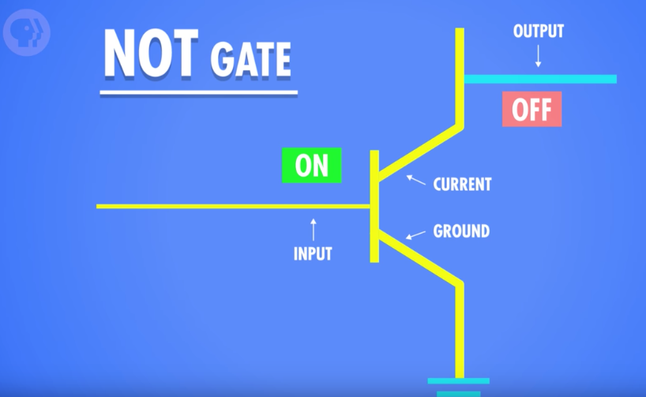
NOT Gate
To build an NOT gate: One transistor
One input and one output
Transistor A: On (True)
Current flows to ground wire and none to output, so output is Off (False)
This picture is a bit hard to understand on its own, I recommend watching a video explanation: https://youtu.be/gI-qXk7XojA?si=HFAPUkIwM0DEMGTo&t=169

Slide 26
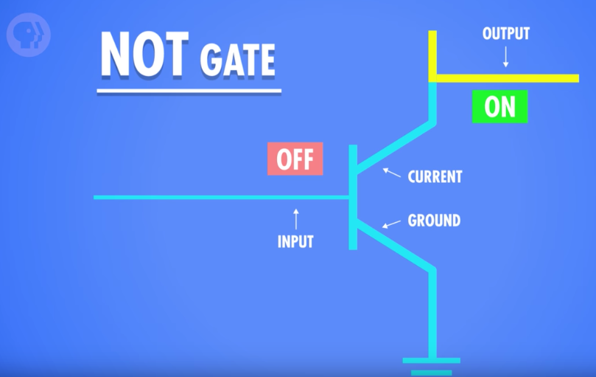
NOT Gate
Transistor A: Off (False)
Current flows to the output wire, so output is On (True)

Slide 27

Boolean Operations: XOR Gate
0
Truth Table
Inputs Outputs
0 0 0
0 1 1
1 0 1
1 1 0
XOR Operation
Only one input value is TRUE for output to be TRUE. If both are true, output FALSE
Not like any other operation in standard algebra!
Operation symbols:
A⊕B, A⊻B , A xor B
0
0
A
A⊕B
0
B
1
1
1
1
0
1
0
1

Slide 28
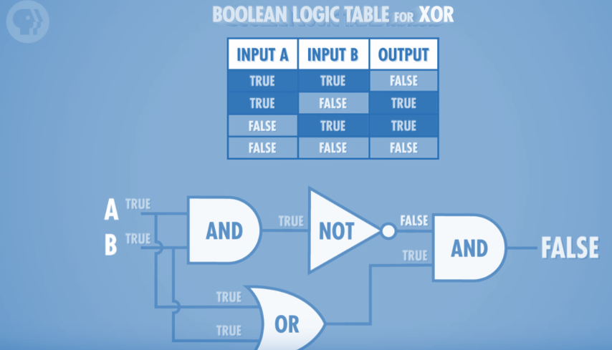
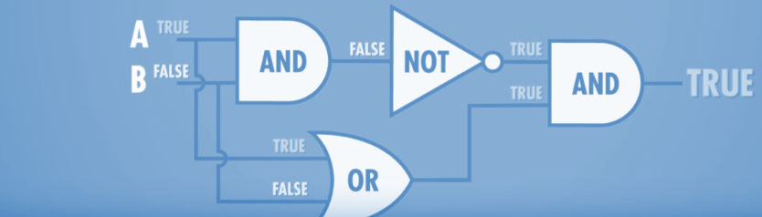
XOR Gate
How to build an XOR gate? We can’t do it directly with transistors-- but we can by combining AND, OR, and NOT gates!
Both of the images above are the same combination of gates; the only difference is the input values

Slide 29
Applications of Logic Gates: Binary Math

Slide 30
Back to the CPU
How do these logic gates help our guy in the box?

Slide 31
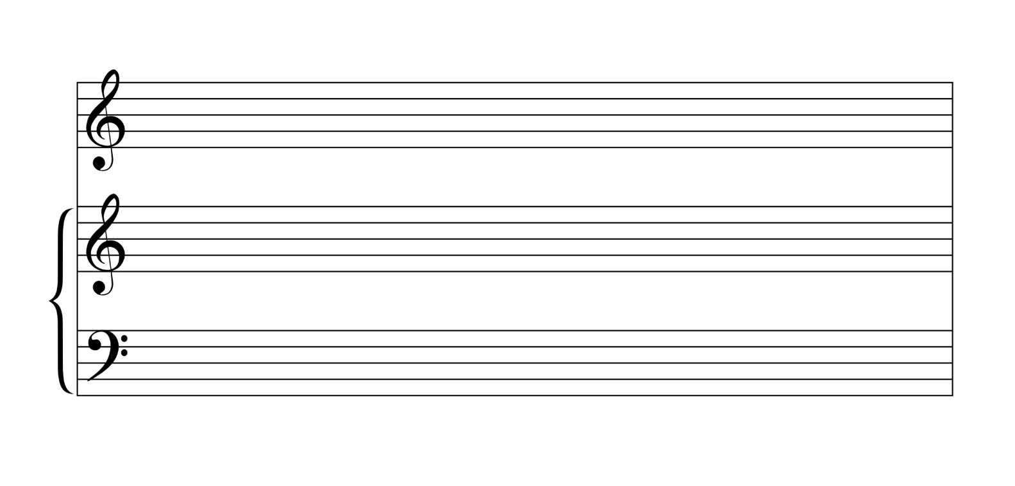
Back to the CPU
In fact, the “guy in the box” isn’t really a guy at all, but a composition of many logic gates
These logic gate compositions (called digital circuits), if arranged in clever ways, can perform all of the complex operations a CPU needs to perform!
To see this, we will study the CPU’s Arithmetic Logic Unit (ALU) to see how logic gates can emulate arithmetic (addition, subtraction, etc.)

Slide 32
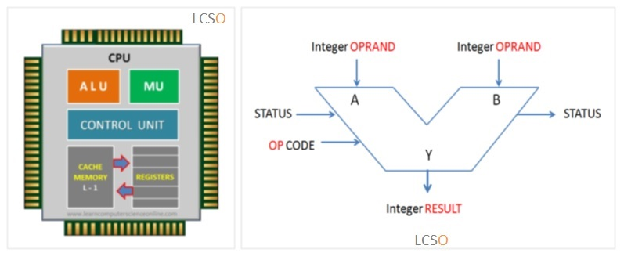
The CPU Arithmetic Logic Unit
The ALU is made up of a combination of logic circuits paced at the clock signal. The ALU is able to perform operations such as:
Add
Add with carry
Subtract
Subtract with borrow
Two’s complement
Increment
Decrement
Pass through
Logical operations (and, or, xor, not or one’s complement)
Bit shift operation

Slide 33
The CPU Arithmetic Logic Unit
Let’s start from the top:
Add
How can we get a logic gate to add bits?
What operations do we need?

Slide 34
The CPU Arithmetic Logic Unit
Let’s start from the top:
Add
How can we get a logic gate to add bits?
What operations do we need?
Start with a truth table!

Slide 35
Adding two bits
Start simple. Let A and B only have 1 bit each
The result should have two bits (why?)
Let’s make a truth table, with two output columns, to represent each bit of the output
one for the “2’s” column, and one for the “1”s column
A + B = 2’s 1’s

Slide 36
Adding two bits
Start simple. Let A and B only have 1 bit each
The result should have two bits (why?)
Let’s make a truth table, with two output columns, to represent each bit of the output
one for the “2’s” column, and one for the “1”s column
A + B = 2’s 1’s
0 0 0 0 adding 0 + 0 should equal 0

Slide 37
Adding two bits
Start simple. Let A and B only have 1 bit each
The result should have two bits (why?)
Let’s make a truth table, with two output columns, to represent each bit of the output
one for the “2’s” column, and one for the “1”s column
A + B = 2’s 1’s
0 0 0 0 adding 0 + 0 should equal 0
0 1 0 1 adding 0 + 1 should equal 1

Slide 38
Adding two bits
Start simple. Let A and B only have 1 bit each
The result should have two bits (why?)
Let’s make a truth table, with two output columns, to represent each bit of the output
one for the “2’s” column, and one for the “1”s column
A + B = 2’s 1’s
0 0 0 0 adding 0 + 0 should equal 0
0 1 0 1 adding 0 + 1 should equal 1
1 0 0 1 adding 1 + 0 should equal 1

Slide 39
Adding two bits
Start simple. Let A and B only have 1 bit each
The result should have two bits (why?)
Let’s make a truth table, with two output columns, to represent each bit of the output
one for the “2’s” column, and one for the “1”s column
A + B = 2’s 1’s
0 0 0 0 adding 0 + 0 should equal 0
0 1 0 1 adding 0 + 1 should equal 1
1 0 0 1 adding 1 + 0 should equal 1
1 1 1 0 adding 1 + 1 should equal 10

Slide 40
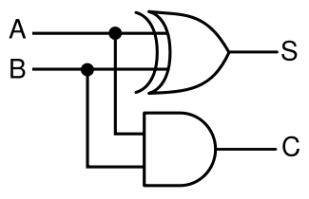
Half Adder Gate: Adding two bits
What gates give us the table below?
Inputs: A, B
Let’s call the 1’s column S = Sum
Let’s call the 2’s column C = Carry
A + B = C S
0 0 0 0 adding 0 + 0 should equal 0
0 1 0 1 adding 0 + 1 should equal 1
1 0 0 1 adding 1 + 0 should equal 1
1 1 1 0 adding 1 + 1 should equal 10

Slide 41
Half Adder Gate: Adding two bits
What gates give us the table below?
Inputs: A, B
Let’s call the 1’s column S = Sum
Let’s call the 2’s column C = Carry
A + B = C S
0 0 0 0 Which gate matches C?
0 1 0 1
1 0 0 1 Which gate matches S?
1 1 1 0

Slide 42
Half Adder Gate: Adding two bits
Inputs: A, B
Let’s call the 1’s column S = Sum
Let’s call the 2’s column C = Carry
A + B = C S
0 0 0 0 Which gate matches C? AND
0 1 0 1
1 0 0 1 Which gate matches S? XOR
1 1 1 0

Slide 43
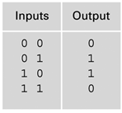
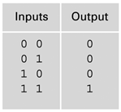
Half Adder Gate: Adding two bits
Inputs: A, B
S = Sum
C = Carry
A + B = 2’s 1’s

Slide 44
Half Adder Gate: Adding two bits
Inputs: A, B
S = Sum
C = Carry
A + B = 2’s 1’s
0 + 0 = 0 0
0 🡪
0
0 🡪
0

Slide 45
Half Adder Gate: Adding two bits
Inputs: A, B
S = Sum
C = Carry
A + B = 2’s 1’s
0 + 1 = 0 1
0 🡪
1
1 🡪
0

Slide 46
Half Adder Gate: Adding two bits
Inputs: A, B
S = Sum
C = Carry
A + B = 2’s 1’s
1 + 0 = 0 1
1 🡪
1
0 🡪
0

Slide 47
Half Adder Gate: Adding two bits
Inputs: A, B
S = Sum
C = Carry
A + B = 2’s 1’s
1 + 1 = 1 0
1 🡪
0
1 🡪
1

Slide 48
Full Adder
Why do we call it a half adder?
D

Slide 49
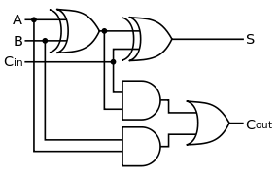
Full Adder
A | B | Cin | S | Cout
0 | 0 | 0 | 0 | 0
0 | 0 | 1
Part of Lab 5….

Slide 50
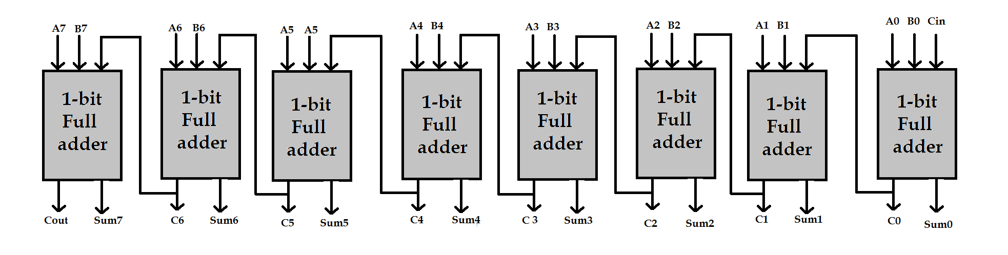
8 bits Full adders

Slide 51
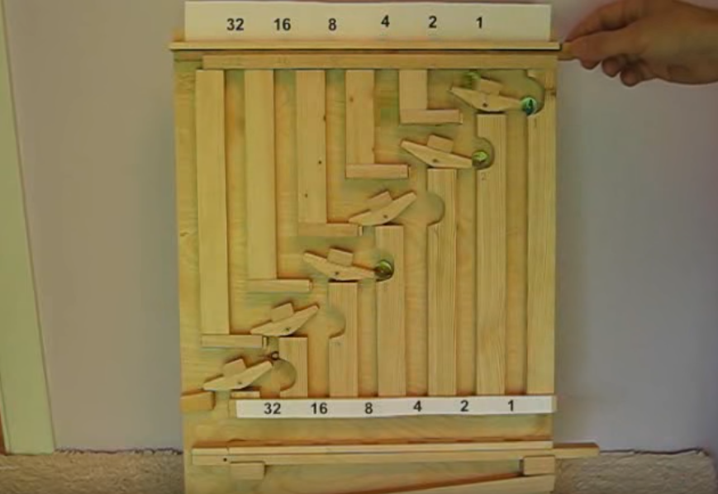
Marble Adding Machine
http://www.youtube.com/watch?v=GcDshWmhF4A&NR=1&feature=fvwp

Slide 52
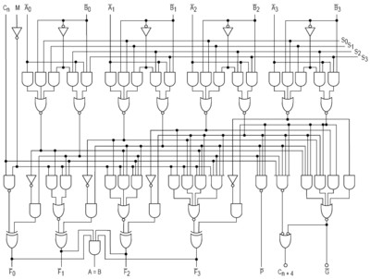
This is a 4-bit CPU

Slide 53
Questions?

